Slide 1

Visual Analytics Project: Realtime Sentiment Analysis
Shohel Rana
M.Sc Student at Arcada University
Twitter Big Data Project Sentimental Analysis

Slide 2
Table of Contents
Introduction
Objective
Dataset Reasoning
Label Choice
Preprocessing Steps
ML Algorithm
PowerBI Dashboard
Challenges

Slide 3
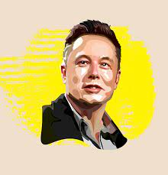
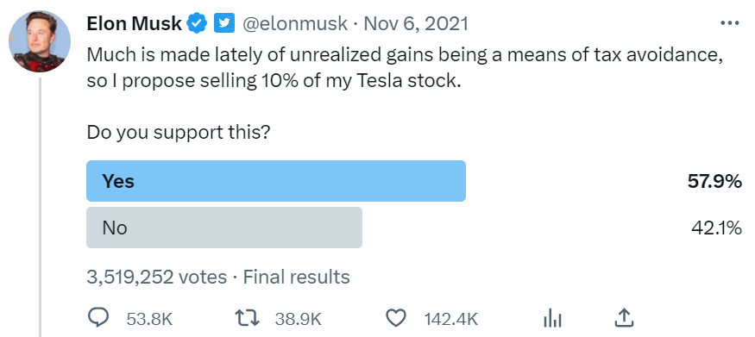
Introduction
Significance of Twitter in shaping global opinions.
Main Aim: Analyze real-time Twitter data for global insights.

Slide 4


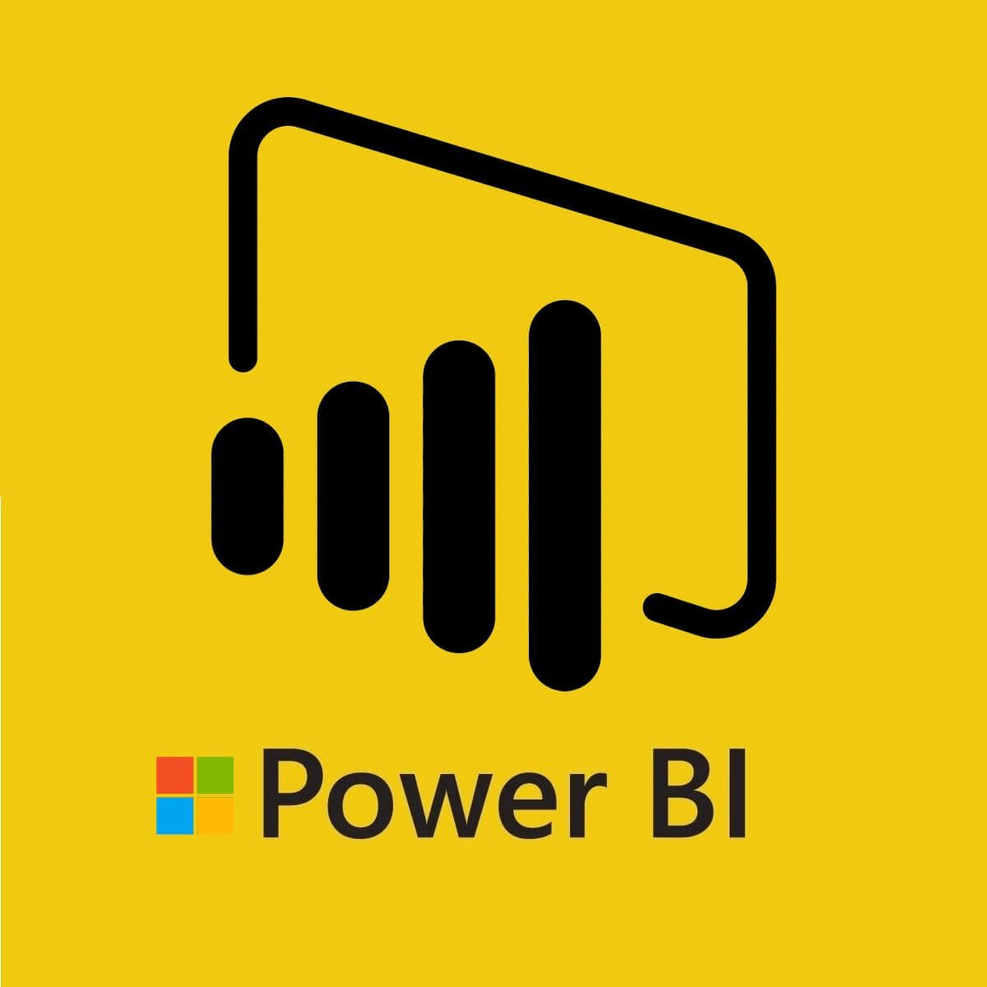
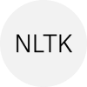
Objective
Analyze thought patterns, tweet frequencies, and user engagement on Twitter.
Launch a Flask app, work in distributed environment & build a Sentiment Analysis ML model
Build an interactive visual dashboard using PowerBI to convey insights

Slide 5
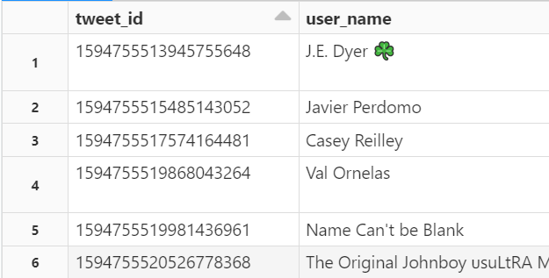
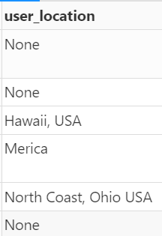
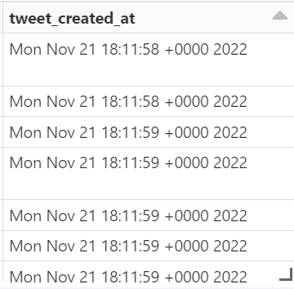
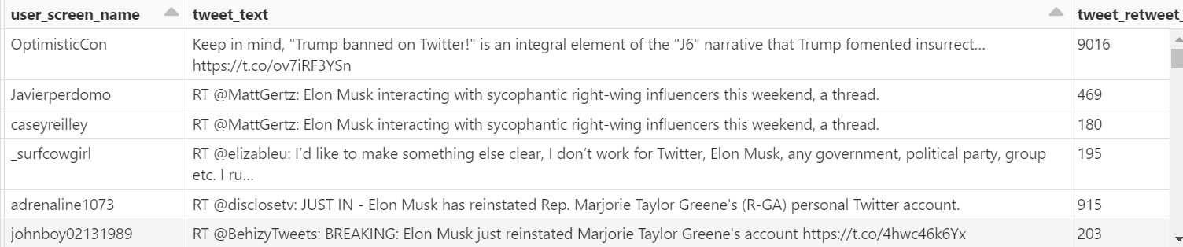
Data
Collected 500000 by Tweepy library

Slide 6
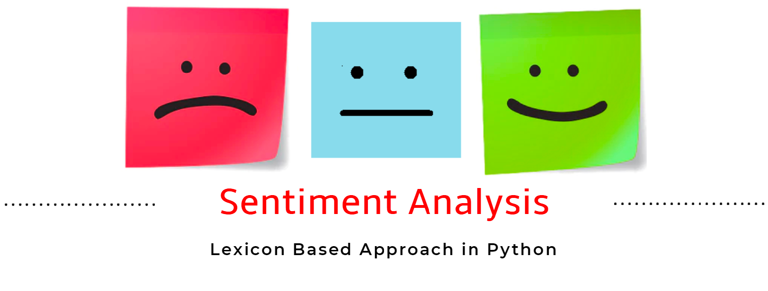
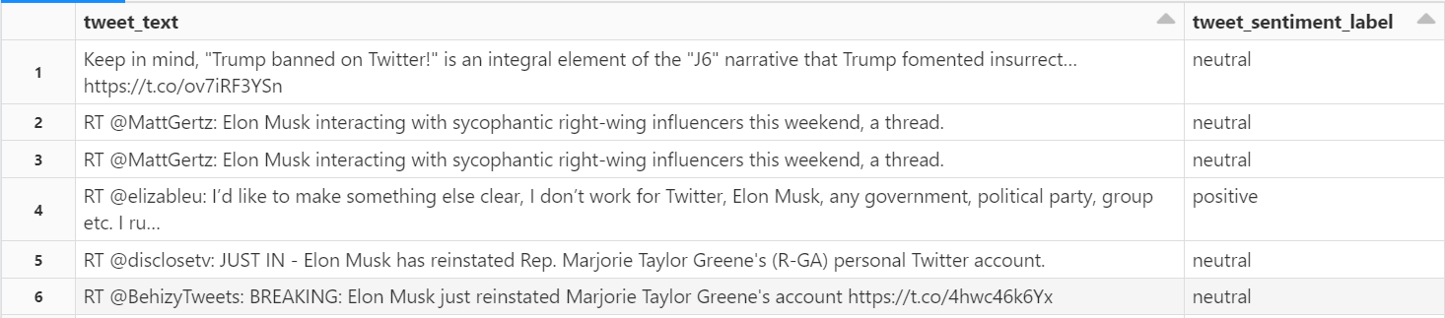
A lexicon-based method (NLTK Vader) was used to label tweets as having a positive, neutral or negative sentiment
Data Labeling

Slide 7
Data Preprocessing
‘Jenna went back to University
Lowercase & remove non-alphanumeric
jenna went back to university
Tokenise
’jenna’,’went’,’back’,’to’,’university’
Remove Stop Words
’jenna’,’went’,’university’
Stem/Lemmatise
’jenna’, ’go’, ’univers’
Remove duplicates/ missing values
Remove URLs
Remove special characters
Substituting multiple spaces with single space
Lowercase all text
Trim the leading/trailing whitespaces
Tokenization
Stop word removal
Countvectorizer & TF-IDF Vectorizer

Slide 8
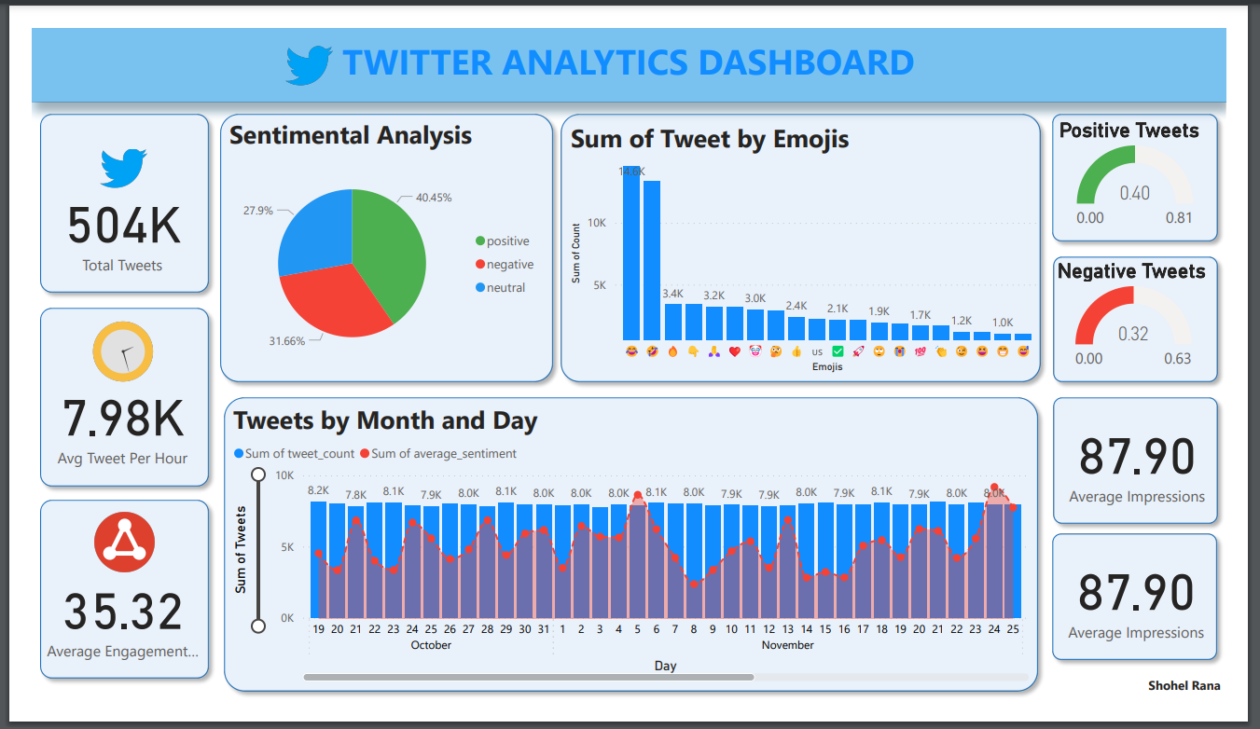
QuickSight Dashboard
Interactive dashboard by predicted sentiment as well as by right/wrong predictions

Slide 9
Challenges & Next Steps
Since only recent tweets were scrapped, reply_count,retweet_count & favorite_count were not useable.
Some of the attributes collected were not useable. Ex. ‘hashtags’.
NLTK Vader lexicon based approach may not be the best way to assign initial sentiments to tweets as it negates the emotion/ logic behind the text & focuses only on count of positive or negative words.
Other data labeling methods can be investigated to label the tweets more accurately.

Slide 10
Conclusion
Enhanced Understanding of Twitter Trends: Showcased Twitter data's capacity to unveil global communication patterns and public sentiment.
Python & Flask in Action: Demonstrated improvements in processing and visualizing complex datasets effectively.
Springboard for Future Exploration: Laid the groundwork for further innovative studies in digital analytics and real-time data interpretation.

